Slide 1
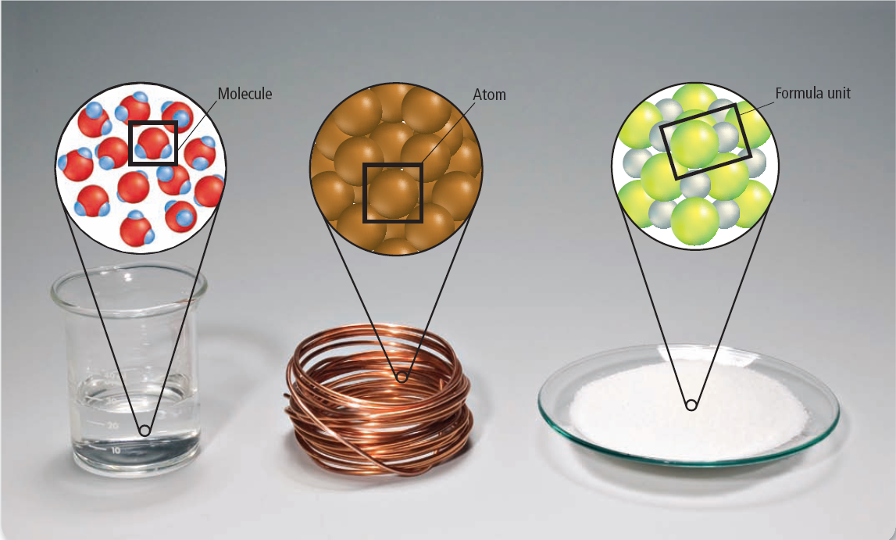
Representative Particles
Water – H₂0
Copper - Cu
Sodium Chloride- NaCl
Molecular Compound
Elements
Ionic Compound

